Slide 1

TRAINING SESSION ON CONVOLUTIONAL NEURAL NETWORK
Presented by:
Dr. Bunil Kumar Balabantaray Assistant Professor
Department of Computer Science and Engineering, NATIONAL INSTITUTE OF TECHNOLOGY MEGHALAYA
Anmol Gautam, Swastik Jena (Member of AI Research Group,NIT Meghalaya)

Slide 2

Introducing Convolutional Neural Networks

Slide 3
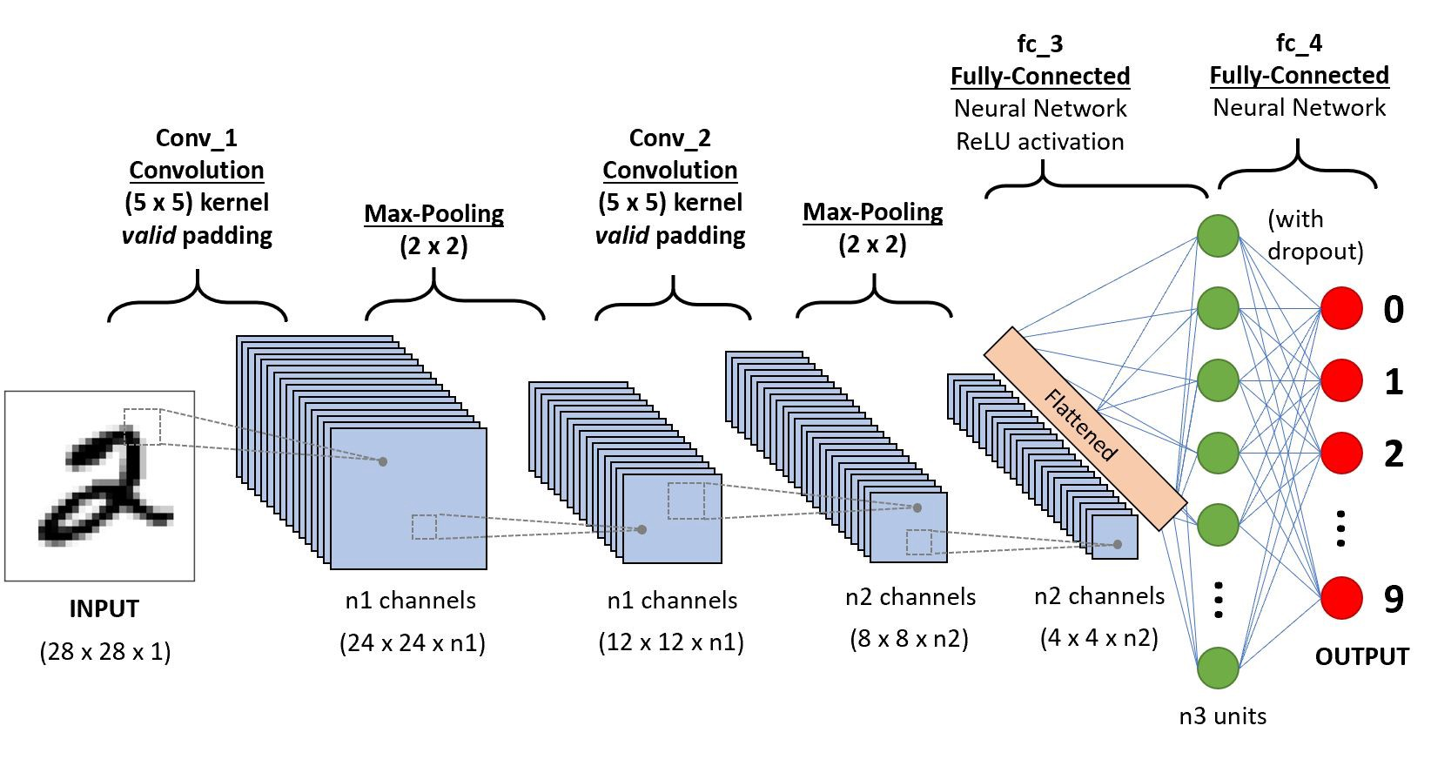
Introducing Convolutional Neural Networks

Slide 4
Introducing Convolutional Neural Networks
preserve the spatial structure of the problem
by learning internal feature representations using small squares of input data
specifically designed to process pixel data.
Convolutional layers learn local patterns using filters/kernels
They are translation invariant
They learn spatial hierarchies
Input and output is a tensor called feature map

Slide 5
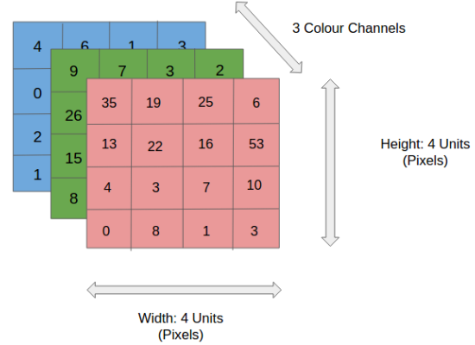
Image Data

Slide 6
Building Blocks Of a CNN
Convolutional Layers
Pooling Layers
Fully-Connected Layers

Slide 7
Convolutional Layers
Filters
Feature Maps
Padding
Stride

Slide 8
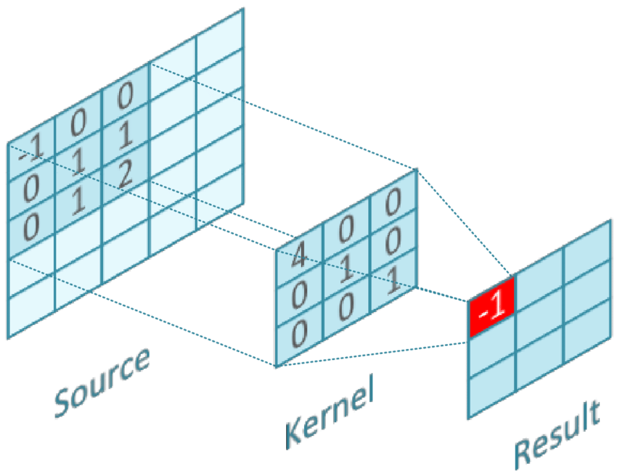
Convolutional Operation

Slide 9
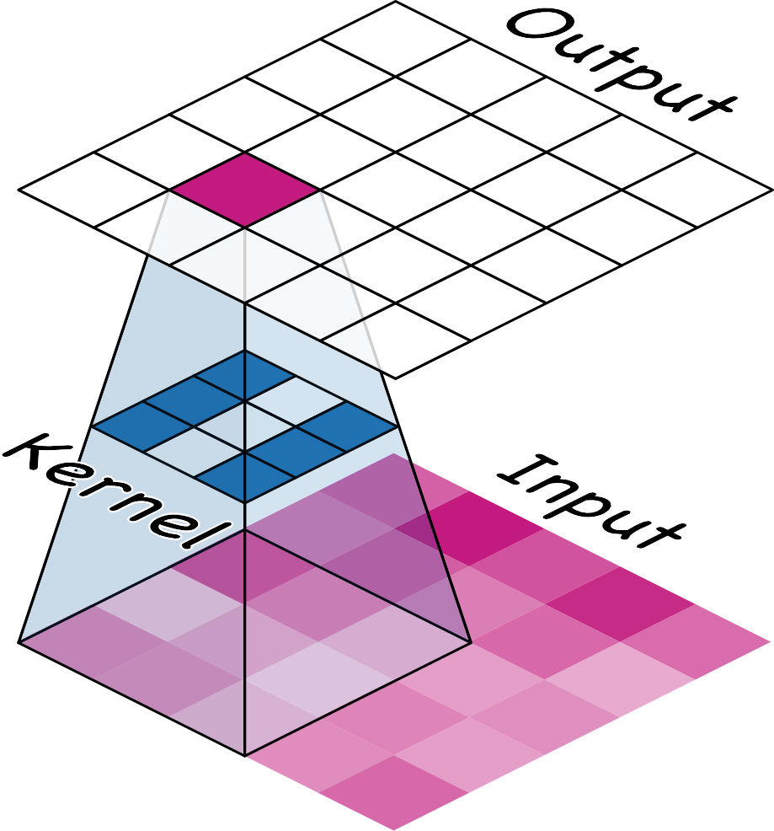
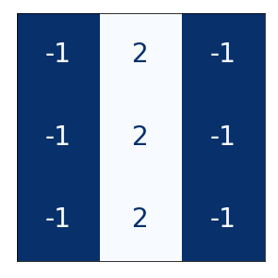
Kernels / Weights / Filters
The weights a convnet learns during training are primarily contained in its convolutional layers. These weights we call kernels.

Slide 10
Kernels / Weights / Filters
The weights a convnet learns during training are primarily contained in its convolutional layers. These weights we call kernels.

Slide 11
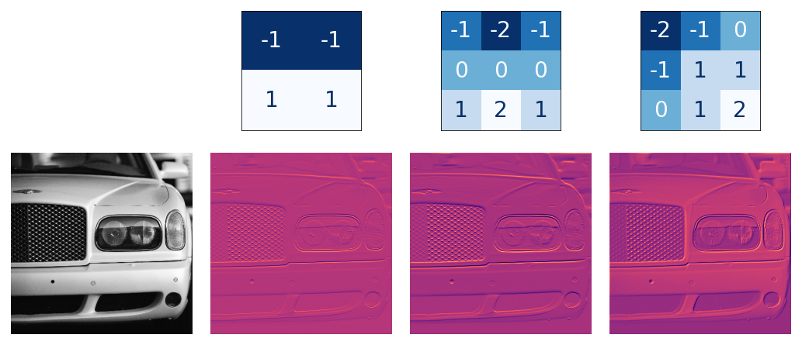
Kernels / Weights / Filters

Slide 12
Padding

Slide 13
Stride
Stride is a component of convolutional neural networks tuned for the compression of images.
Stride is a parameter of the filter that modifies the amount of movement over the image.

Slide 14
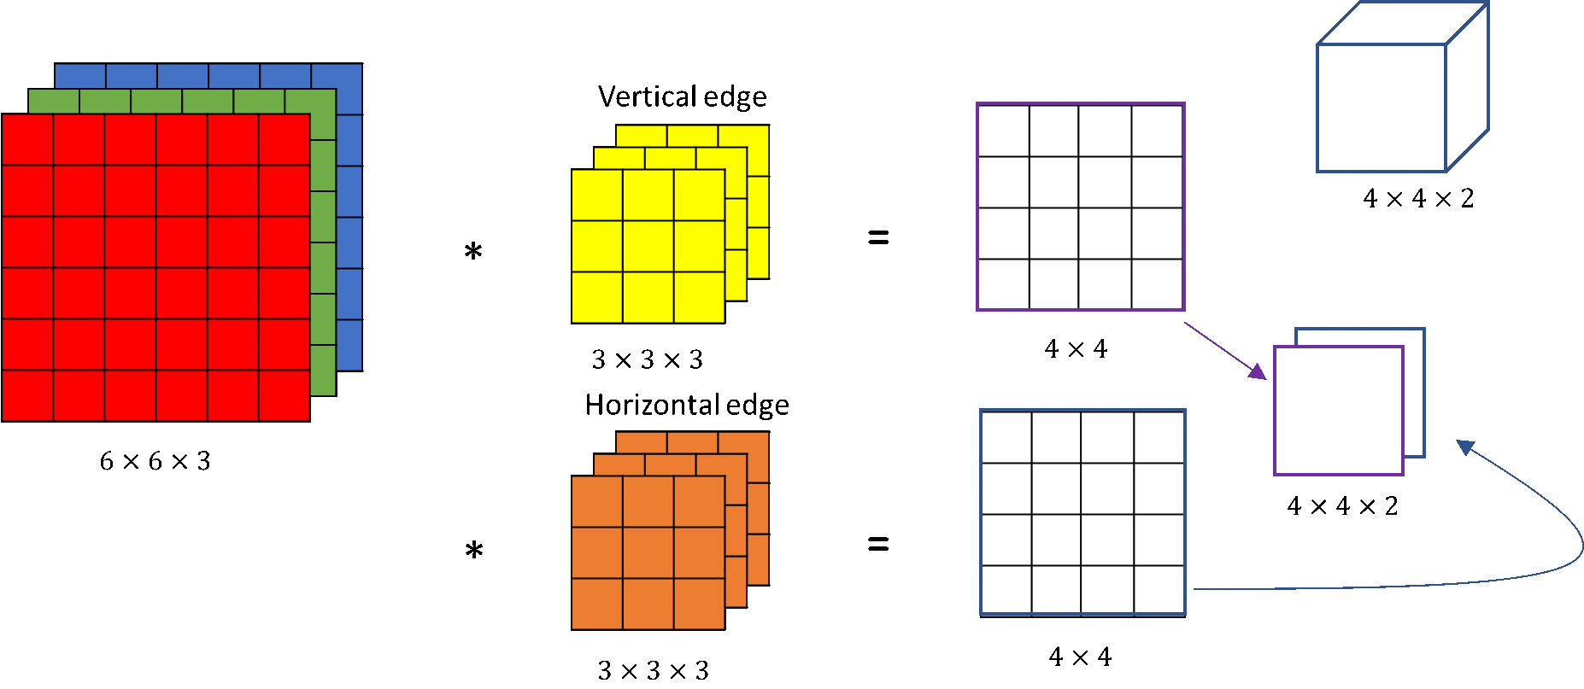
Convolution on RGB images

Slide 15
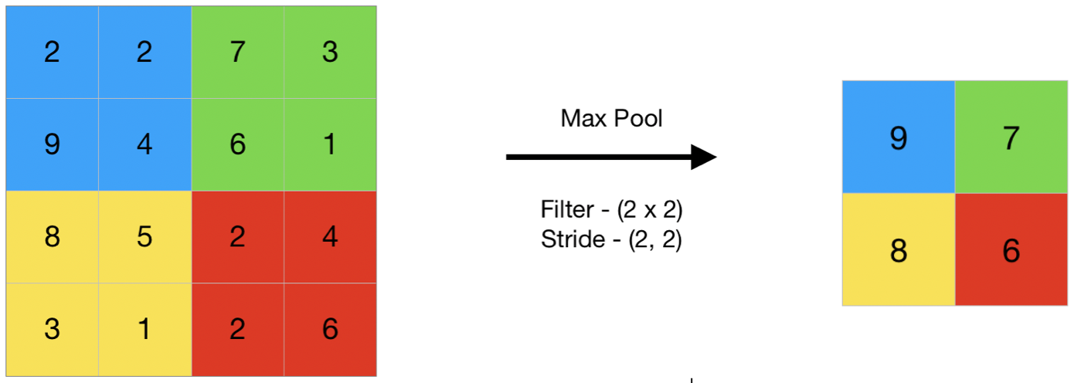
Pooling Layers
Average Pooling
Max Pooling
Etc.

Slide 16
Fully Connected Layers
Feed forward layers
Non linearity
After feature extraction used to create non linear combinations for predictions

Slide 17
Fully Connected Layers
Feed forward layers
Non linearity
After feature extraction used to create non linear combinations for predictions

Slide 18
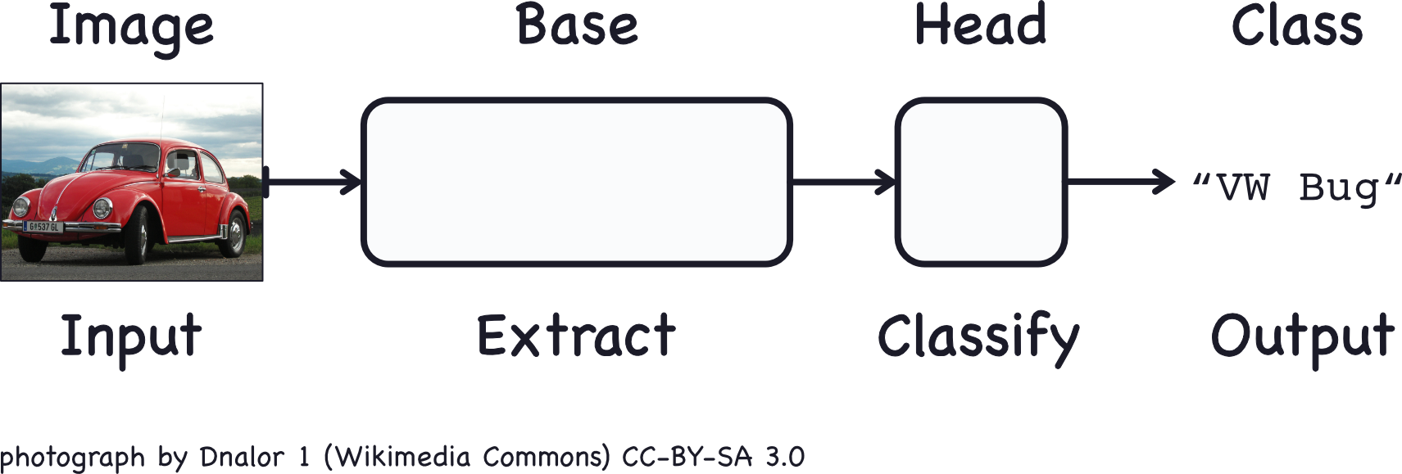
Convolutional Classifier

Slide 19
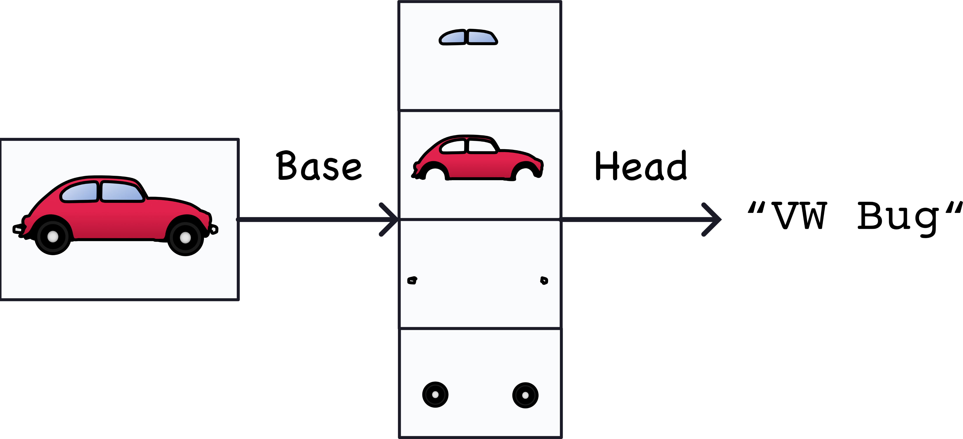
Convolutional Classifier

Slide 20
Feature Extraction
The feature extraction performed by the base consists of three basic operations:
Filter an image for a particular feature (convolution)
Detect that feature within the filtered image (ReLU)
Condense the image to enhance the features (maximum pooling)

Slide 21
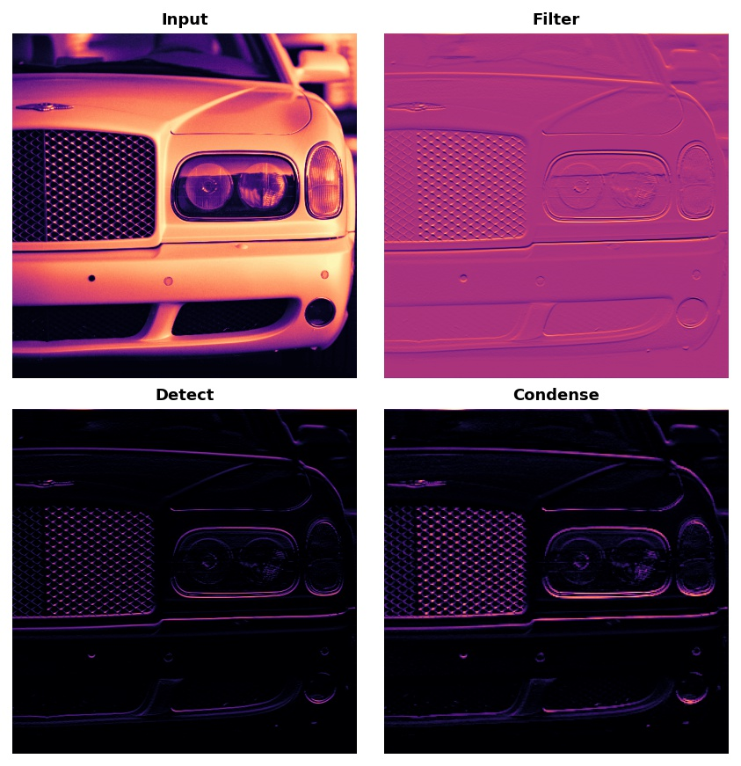
Feature Extraction

Slide 22
One Layer Of CNN

Slide 23
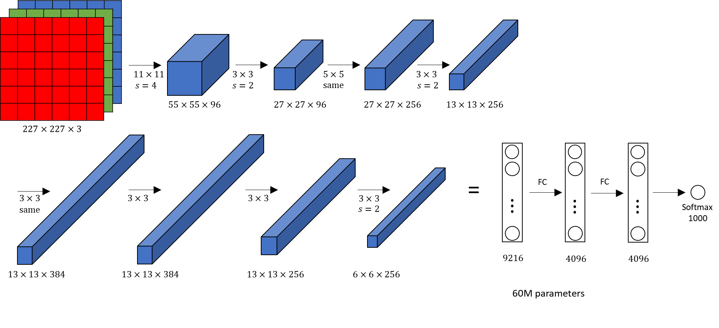
Alexnet

Slide 24
Transfer Learning
Instead of building a convnet from scratch if we can reuse the learned model.
E.g. alexnet, VGG16, etc.
they were trained on different dataset (IMAGENET)
Lets explore this

Slide 25
Case 1
Extract Features from the input
Use just before we reach flatten layer

Slide 26
Case 2
Freeze initial few layers
Only allow training on last few layers on new dataset by modifying them or using another classifier all together

Slide 27
Case 3
Tune the complete model
Keep learning rate very small

Slide 28
Thank You

